Slide 1

HNU
Augmenting TV Show via
Uncalibrated Camera Small Motion Tracking in Dynamic Scene
Authors: Yizhen Lao, Jie Yang, Xinying Wang, Jianxin Lin, Yu Cao, Shien Song
Proceedings of the 29th ACM International Conference on Multimedia CCF A
实事求是 敢为人先
Huiqing Zhang
March 22, 2022

Slide 2
CONTENTS
Section 1
Brief Introduction
Section 2
Related Work & Motivation
HNU
Section 3
Contributions
Section 4
Proposed Methodology
Section 5
Main Results
Section 6
Performance Evaluation
Section 7
Conclusion

Slide 3

HNU
01
Brief Introduction

Slide 4

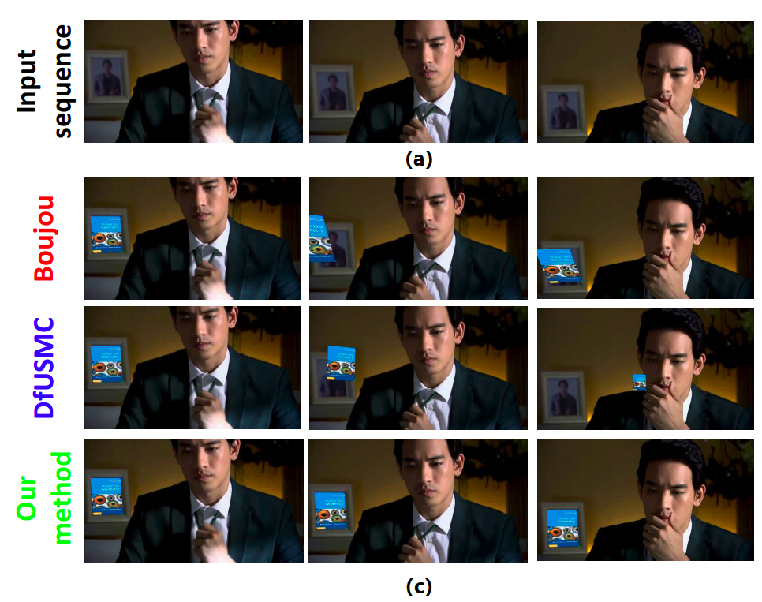

Brief Introduction
Augmenting the sequence of “shots” by producing visual effects (VFX) is a well-known and vital task in filmmaking. An accurate camera tracking is essential to convincingly composite objects onto live-action footage.
This paper focus on the TV show augmentation (inserting virtual objects into the original shot while perfectly matched perspective and appear seamless)
Notes:
Therefore, the task of TV show augmentation becomes an open but challenging problem

Slide 5
HNU
02
Related Work & Motivation

Slide 6

The existing works are shown as following:
stick barcoded markers
use multiple cameras rig
using an auxiliary camera
an internal measurement unit (IMU)
Additional Information Assistance
Structure-from-Motion
all the classical SfM methods are based on epipolar geometry => Compute F and decomposition it into the relative pose
Uncalibrated AR
Commercial Matchmove Software
Structure-from-Small-Motion (SfSM)
the majority of SfM assume the multiple views are well pre-calibrated
some uncalibrated SfM methods VisualSfM , COLMAP , OpenMVG
assume wide translation and static scenes
Boujou , ACTS , Camera-Tracker tool in Adobe After Effect
depth from uncalibrated small motion clip(DfUSMC)

Slide 7
Motivations
Additional Information Assistance
=> TV show shots’ post-produce without calibration information
Structure-from-Motion
=> TV show shots are commonly under small camera motion, leading to an extraordinary narrow baseline
Uncalibrated AR
=> The TV show shots are with highly dynamic scenes and small motion
Commercial Matchmove Software
=> Dynamic scenes where a moving foreground object such as a real actor occupies a large part of the background are frequently occurs in the TV show.
Structure-from-Small-Motion (SfSM)
=> All methods assume a rigid scene without considering the captured moving objects, which does not hold in a TV show shot.

Slide 8
Motivations
The shot of a TV show is common with:
uncalibrated camera with dramatical lens zoom
highly dynamic scene
extreme narrow-baseline motion
These differences make the classical camera tracking approaches fail when using a TV show as input.
From the discussion above, we found out that to augment TV show robustly, an uncalibrated camera small motion tracking method in highly dynamic scenes is still absent in current literature.
Such a solution could benefit the post-production and post-edit of TV show or even the social sharing short-form videos.

Slide 9
HNU
03
Contributions

Slide 10
Contributions
Present a novel uncalibrated camera small motion tracking approach for dynamic scenes called Dynamic-UCSMT
We propose a completed pipeline to augment the TV show shot in the post-production step by using Dynamic-UCSMT
We collected a large dataset of real TV show shots, and extensive evaluations demonstrate the superiority of our method to existing works and commercial software.

Slide 11
HNU
04
Proposed Methodology

Slide 12
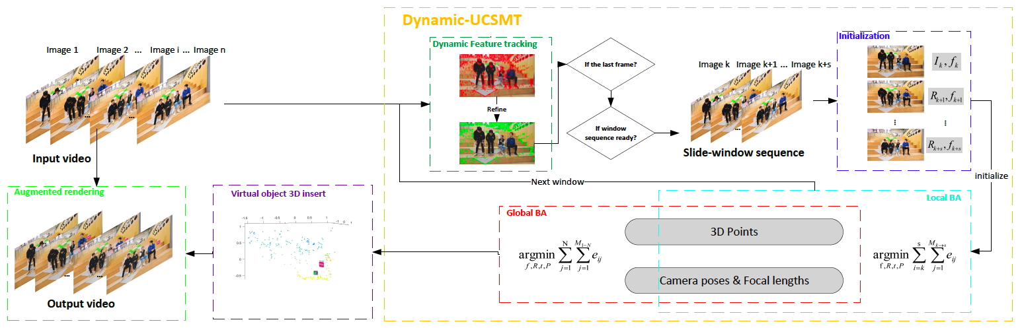
Overview

Slide 13
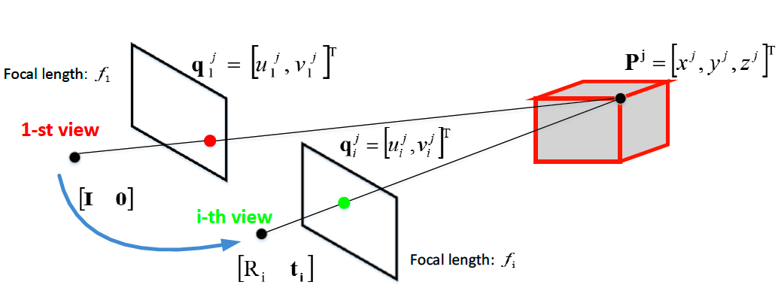
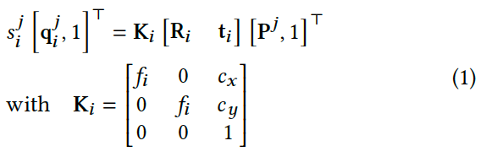
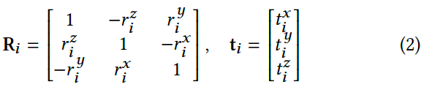
Dynamic-UCSMT
Camera Model for Small Motion
use the perspective projection model by ignoring lens distortion
use small angle approximation for the camera rotation parameterization

Slide 14
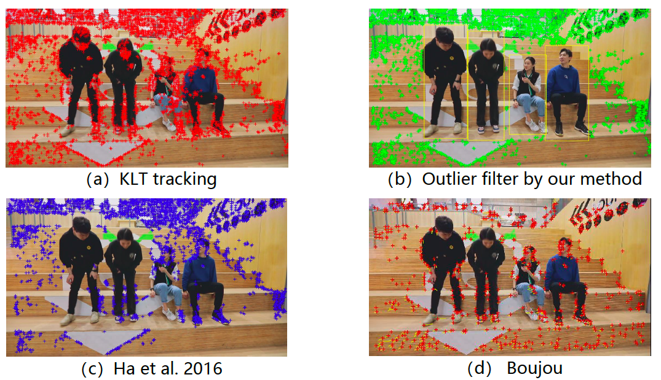
Dynamic-UCSMT
Feature Tracking
Use Harris corner and Kanade-lucas-Tomasi (KLT) tracker to match the features over the sequence
Perform YOLOv3 to detect Humans remove the feature on human
Compute the homography between consecutive frames to filter out the remained outliers

Slide 15
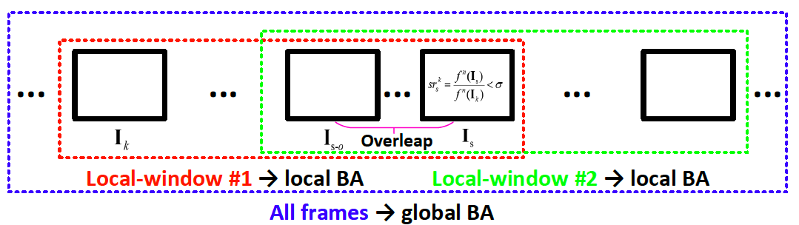
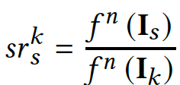
Dynamic-UCSMT
Local-window Slicing in Dynamic
Conduct a sliding window to track the camera motion locally
The feature survival rate of 𝑠^{th} frame:
We track the feature points from the 𝑘^{th} and compute the survival rate over each frame sequentially. Once 𝑠𝑟^{𝑘}_{𝑠}< σ, we slice the 𝑘^{th} to 𝑠^{th} as a local-window sequence as input of a local BA
To ensure the continuity over the whole sequence, we set the (𝑠 − 𝑜)^{th} frame as the first frame of the next local-window, which leads to overlap with 𝑜 frames length between two consecutive local-windows.

Slide 16
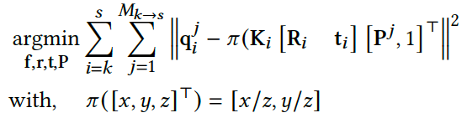
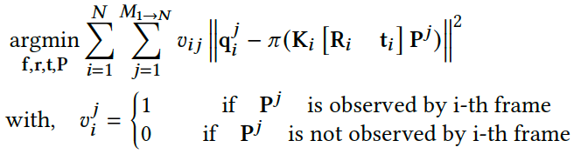
Dynamic-UCSMT
Bundle Adjustment
Design a sliding-window BA paradigm with local and global optimization
Local BA
Global BA
BA Optimization
Advantages
Use the Levenberg-Marquardt(LM) algorithm to refine the camera poses, focal lengths, and 3D points by minimizing the cost functions above
Derive the closed-form Jacobian matrix in both local and global BAs via chain rule to speed up the iterative optimization
significantly lower number of parameters
track the reliable features

Slide 17
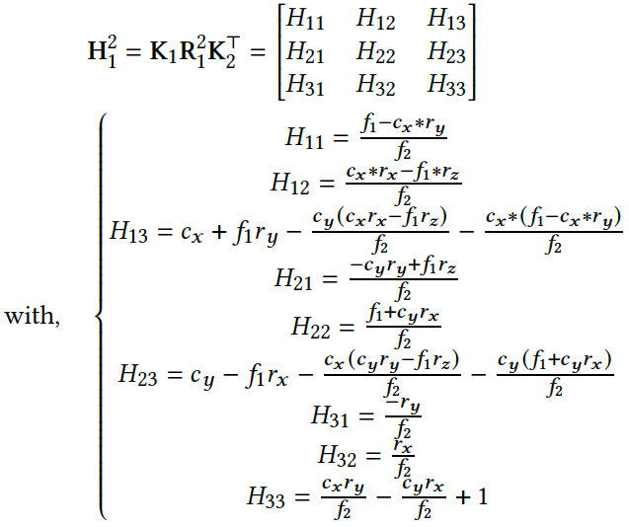
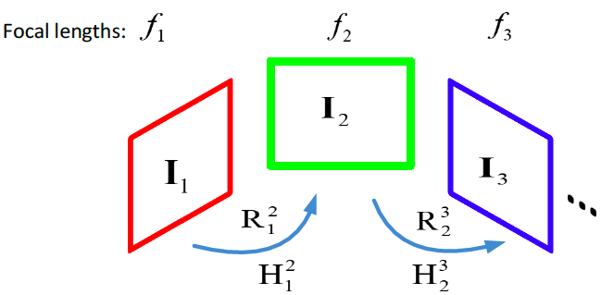
Dynamic-UCSMT
Initialization
Homography-based Uncalibrated Relative Rotation Solver
I₁ and I₂ hold for pure rotation assumption
ignore the translation between two consecutive views
compute their relative rotation and focal lengths simultaneously with a analytical solution

Slide 18
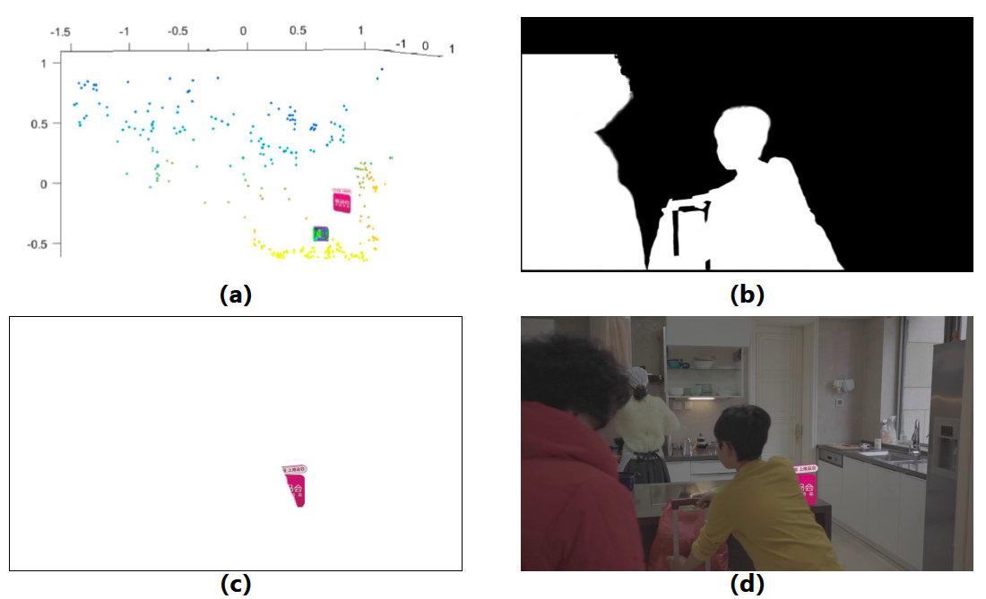
Augment TV Show Shot
Virtual Objects Insert
inserting 3D virtual objects into the
reconstructed scene followed by projection in each frame
Virtual Objects reprojection
using OpenGL
Oclusion handling procedure
human bounding boxes & reprojected virtual objects => intersection => DeeplabV3+ extract the accurate masks of human
Compute depth of human => virtual objects’depths > human depth => reprojected virtual objects based on the intersection

Slide 19
HNU
05
Main Results

Slide 20
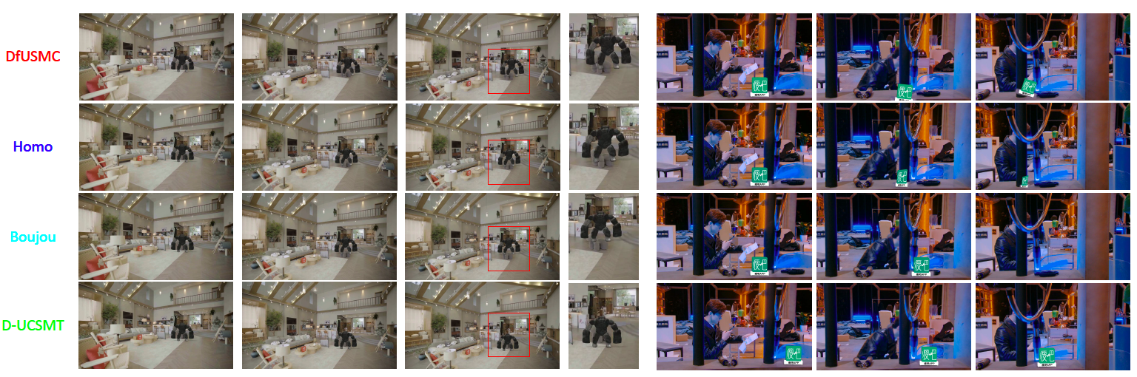
Contributions

Slide 21
HNU
06
Performance Evaluation

Slide 22
Dataset and Comparison Methods
Dataset
A comprehensive dataset of 1000 real production shots (3s 10s, 25fps) collected from real variety shows, series, and animations of Mango TV.
Selected TV shots with 5 categories:
(I) interview, (II) quick rotation, (III) faster zooming, (IV) small translation, and (V) crowd
Comparison Methods.
D-UCSMT (Ours)
DfUSMC: address the uncalibrated camera small motion problem that is strongly related to this paper
Homo3: classical image stitching pipeline
Boujou: Commercial camera tracking software

Slide 23
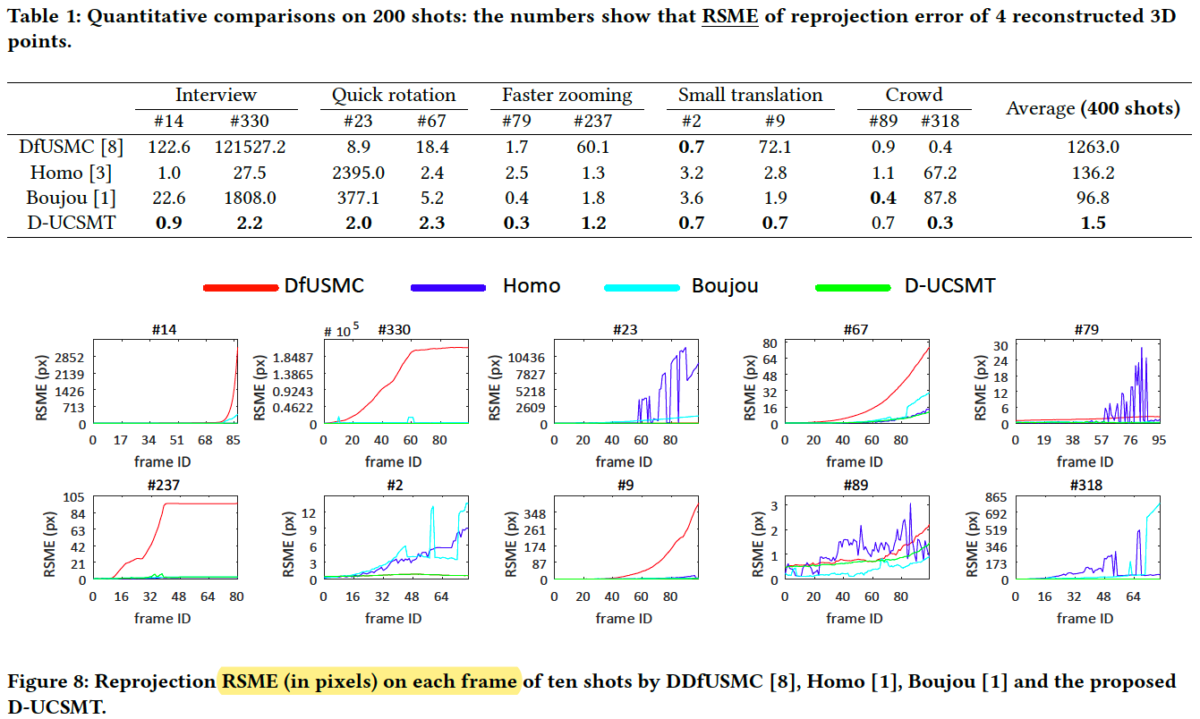
Reprojection Error
Compute the root-mean-square error (RSME) between the four reprojection and image measurements (GT).

Slide 24
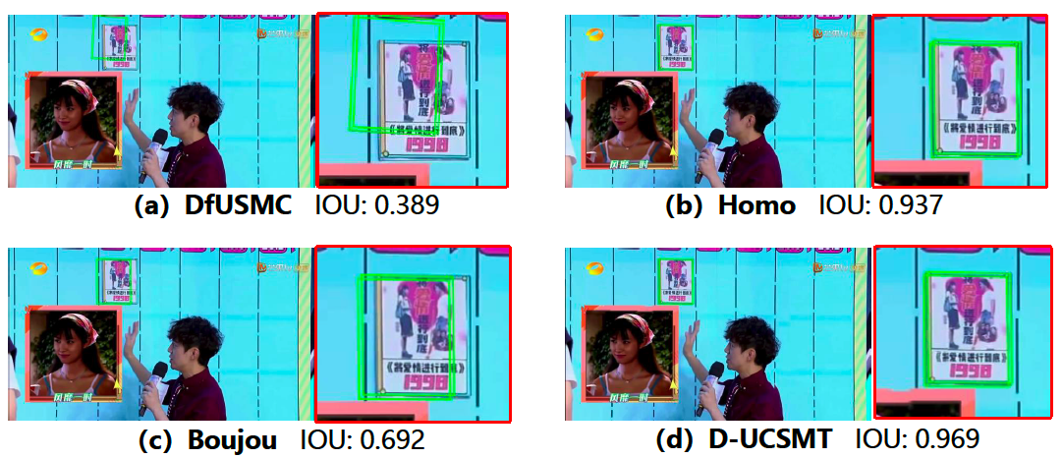
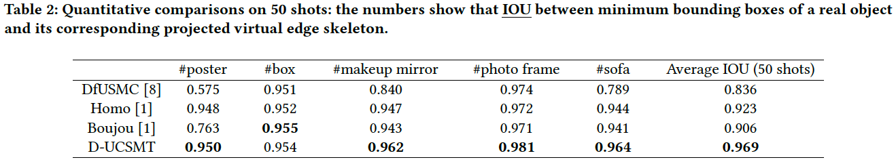
Intersection Over Union (IOU)
Evaluate the performances based on IOU between minimum bounding boxes of a real object and its corresponding projected virtual edge skeleton

Slide 25
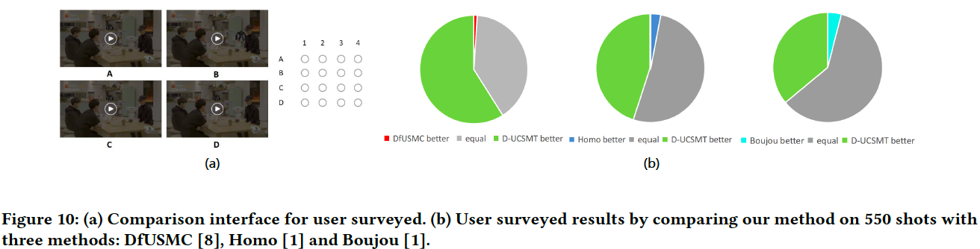
Visual Comparisons
This paper surveyed 20 users to provide preferences for 550 augmented TV show shots by DfUSMC, Homo, Boujou and D-UCSMT based on their visual perception.

Slide 26
HNU
07
Conclusion

Slide 27
Conclusion
This paper has introduced a practical solution that can track uncalibrated cameras with small motion and reconstruct the 3D scene accurately called D-UCSMT.
It matches the TV show slotting style, namely, faster zooming, small motion, and quick rotation without intrinsic information (focal length).
As a result, we can further add the virtual objects (elements) into the reconstructed 3D scene, then composite them back into the original shot while perfectly matched perspective and appear seamless.
The effectiveness of our method in augmenting TV shows against state-of-the-art works and commercial software products.

Slide 28
HNU
Thank you
实事求是 敢为人先

